Slide 1

Authentication
What is Authentication?

Slide 2
Authentication
Why we verify the identity of a user?
Bank account
Picture collection
Shows information specific to a user and track information that we want.
The authentication type is set in the configuration file
User.Identity

Slide 3
Different Types of Authentication
Windows Authentication
Forms Authentication
OpenID / Oauth
Authentication

Slide 4
Windows authentication
Typically used for Intranet Applications
Uses components and services from the OS
“Integrated authentication” – single sign on through Active Directory server
Works on variety of browsers
It is not recommended for Internet applications
Users from different domains
Users using different operating systems

Slide 5

Forms Authentication
GET -> POST -> Redirect
Get a login or registration form
POST back the input to a controller action
If credentials are correct, redirect to another controller action (members area)
Cookies – (.ASPXAUTH=…)
Session – (.ASP.NET_SessionId=…)
Secure socket layer - SSL

Slide 6
Forms Authentication
Return the login form via GET request
By default every Action method in ASP.NET MVC will handle requests via GET
Restricts action method so that it handles only HTTP GET requests
[HttpGet]
[AllowAnonymous]
public ActionResult Login(string returnUrl)
{
ViewBag.ReturnUrl = returnUrl;
return View();
}

Slide 7
Forms Authentication
Process the POST request of the login form
Restricts action method so that it handles only HTTP POST requests
[HttpPost]
[AllowAnonymous]
[RequireSSL]
public ActionResult Login(LoginModel model, string returnUrl)
{
if (ModelState.IsValid && WebSecurity.Login(model.UserName, model.Password, persistCookie: model.RememberMe))
{
return RedirectToLocal(returnUrl);
}
ModelState.AddModelError("", "The user name or password provided is incorrect.");
return View(model);
}
This request must be executed through a secure socket layer
Redirect the user if the login was successful

Slide 8
Configure OpenID / OAuth
Configuration takes place during application start
public static class AuthConfig
{
public static void RegisterAuth()
{
//OAuthWebSecurity.RegisterMicrosoftClient(
// clientId: "",
// clientSecret: "");
//OAuthWebSecurity.RegisterFacebookClient(
// appId: "",
// appSecret: "");
//OAuthWebSecurity.RegisterGoogleClient();
}
}

Slide 9
OpenID / OAuth
DotNetOpenAuth library
Authentication through external services
Don’t need to manage passwords
Easier registration and authentication process
Similar to Forms authentication
Cookies
Redirects

Slide 10

Authorization
Authorization management in ASP.NET MVC

Slide 11
Authorization and Roles
Authorization is giving permissions
Give permission to see a specific page
Restrict someone to delete something
Authorization can be done against
Anonymous users
Already registered user or group of users
Roles
Authorization on a controller or an action
Sets a cookie (.ASPXROLES=…)

Slide 12
Different approaches for Authorization
Pipeline Authorization
Intra-app Authorization

Slide 13
Pipeline Authorization
URL authorization module
It is not recommended because it depends on a hardcoded path. MVC has powerful routing mechanism that can change the route and open security holes.
<location path=“customers”>
<system.web>
<authorization>
<allow roles=“Technical Support” />
<deny users=“*” />
</authorization>
</system.web>
</location>

Slide 14
Roles Authorization
Roles in ASP.NET MVC
[AllowAnonymous]
public ActionResult Register()
{
return View();
}
[Authorize(User=“Niki”)]
public ActionResult Register()
{
return View();
}
[Authorize(Role=“Administrator”)]
public ActionResult Register()
{
return View();
}

Slide 15
Simple Membership

Slide 16
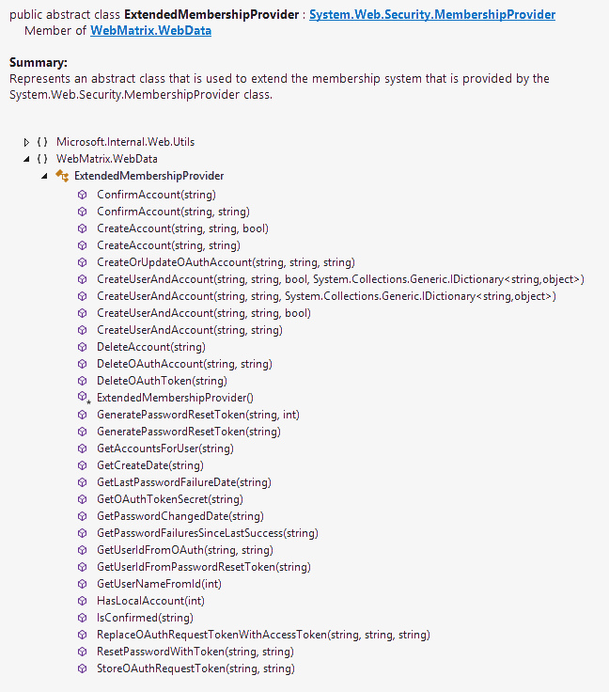
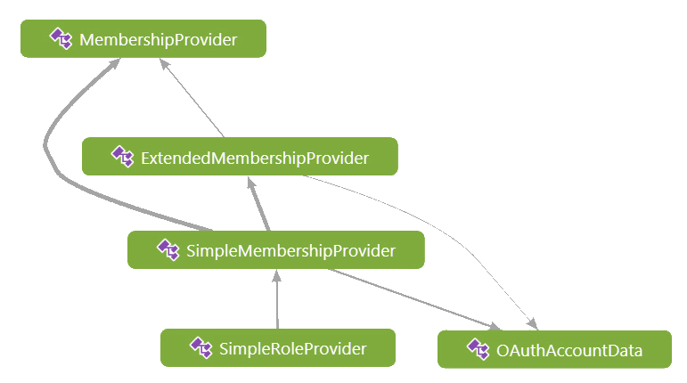
Membership system
Membership classes
Abstract class part of the System.Web.Security
Abstract class that inherits MembershipProvider and is part of WebMatrix.WebData
Implementation of the ExtendedMembership class

Slide 17
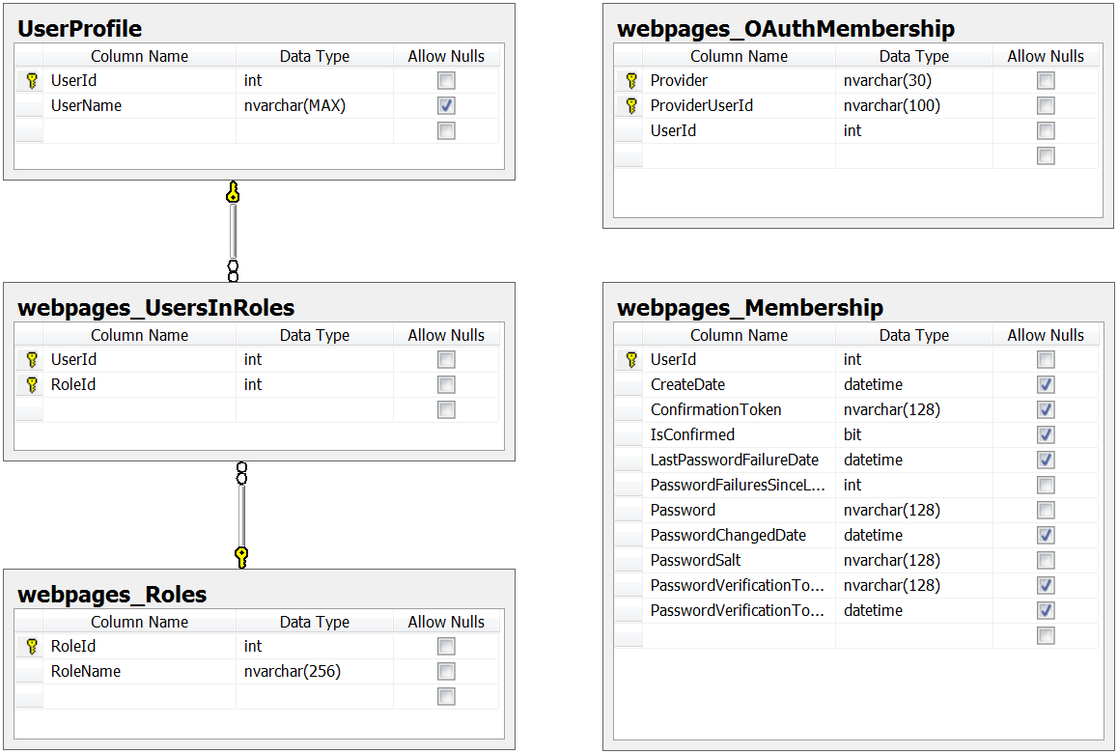
Simple membership schema
Works with existing schema
It’s easy to integrate it with existing Entity Model

Slide 18




Free Trainings @ Telerik Academy
“C# Programming @ Telerik Academy
csharpfundamentals.telerik.com
Telerik Software Academy
academy.telerik.com
Telerik Academy @ Facebook
facebook.com/TelerikAcademy
Telerik Software Academy Forums
forums.academy.telerik.com

